Slide 1
UI/UX Worksheet
Project Title
PetMatch
Team members
6530262 Min Myint Moh Soe
6530289 Sai Oum Maing
6622085 Min Htet
6520102 Aung Bhone Naing
6530198 Heang Mengtry

Slide 2
Day 6

Slide 3
Individual assignment: Sketch your app (5%)
30 mins
Objective
To sketch the interfaces of the final project.
Instructions
For each team member, sketch a page of the application that you think can solve the user’s problem on a paper. Write your ID and name on your sketch.
Annotate the important objects on your sketch.
Once finished, take the picture of your sketch.
Then, insert the picture of your sketch and your name in the worksheet.
Note:
A team is required to have at least 4 important sketches.
You can insert more slides in the worksheet (if any).

Slide 4

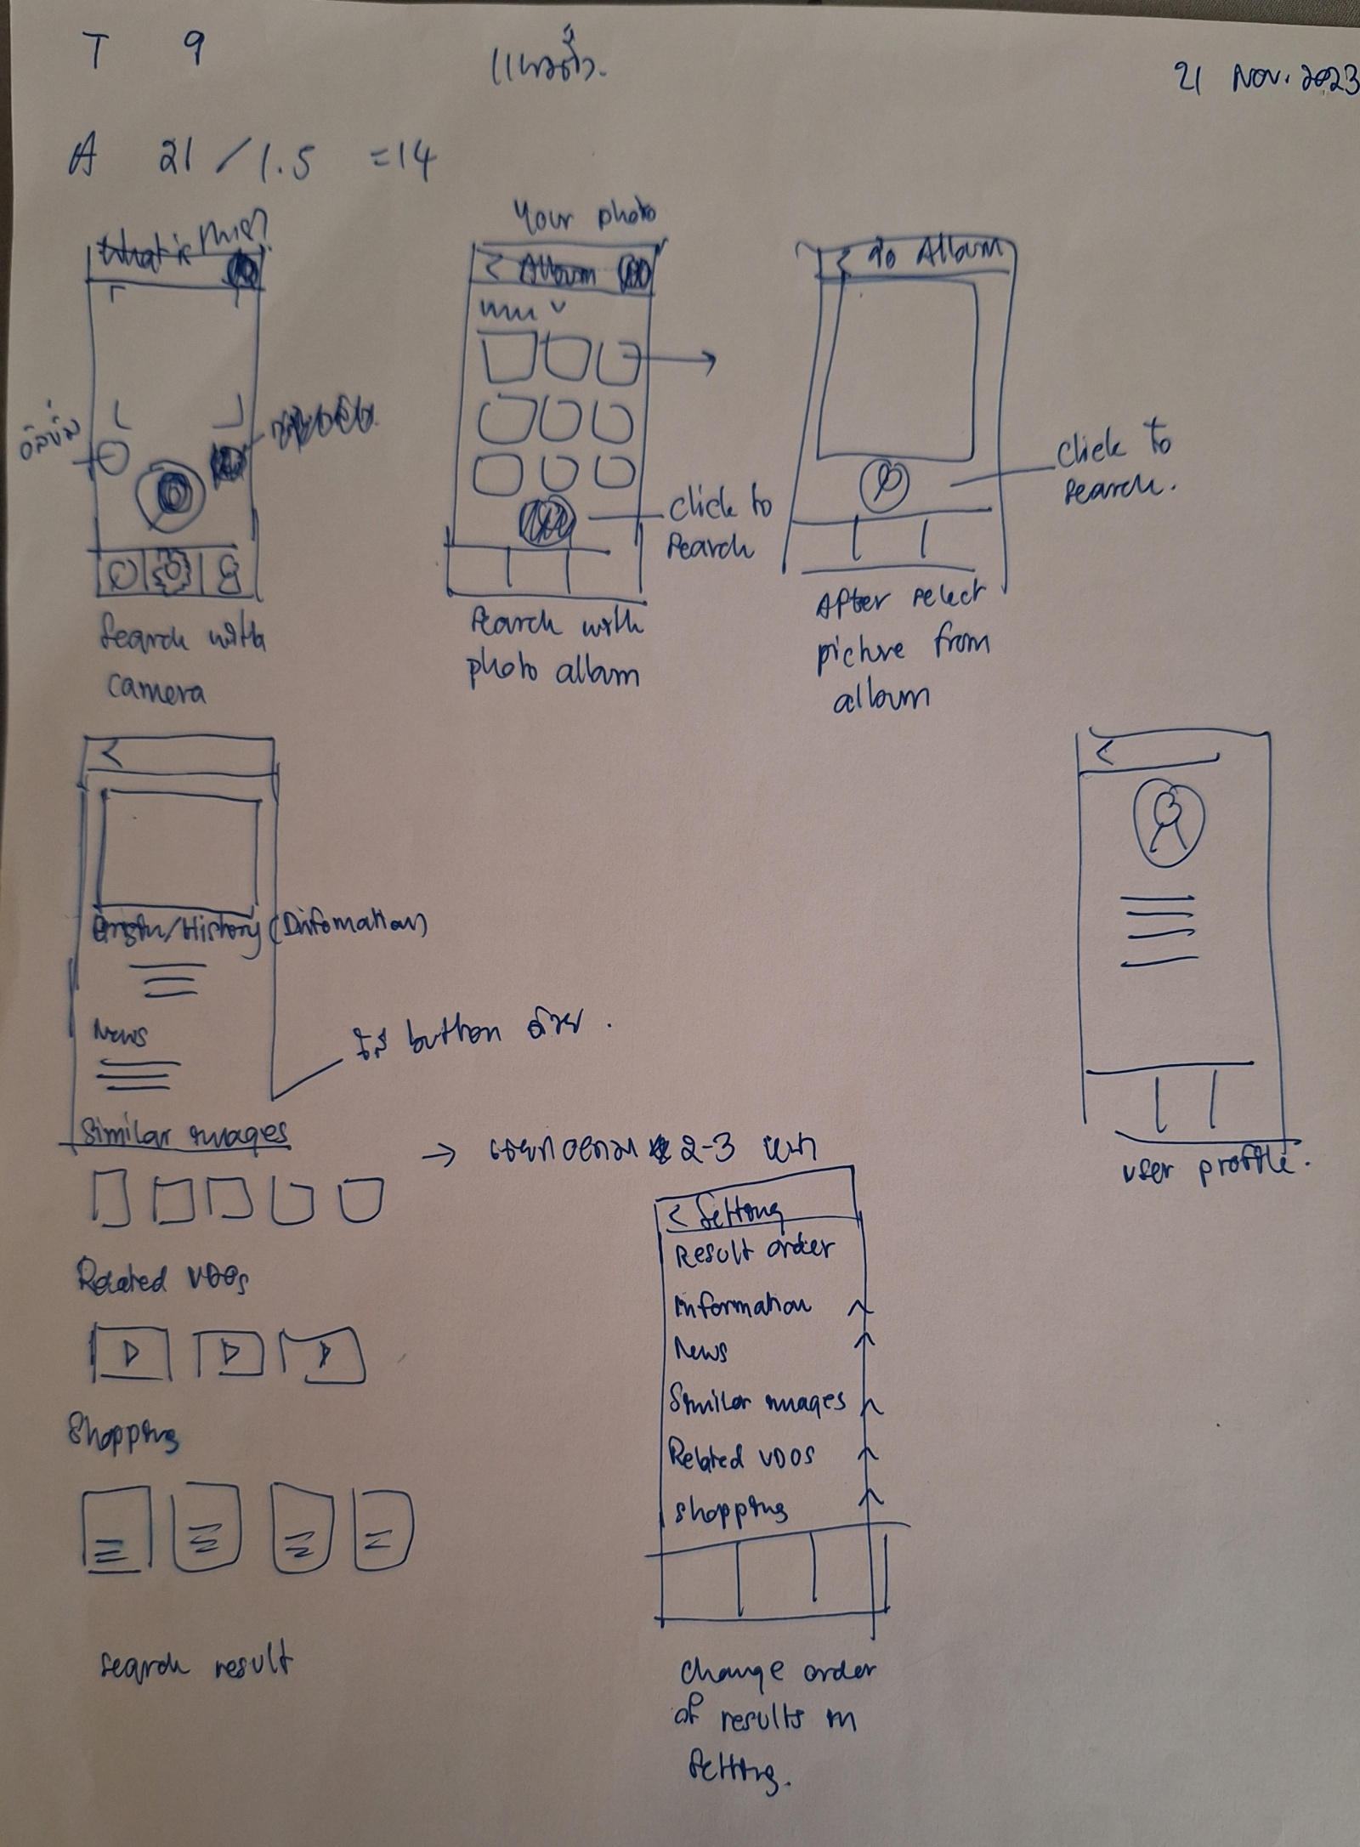
Sketch (example)
(6615000 John Smith)
(6615000 John Smith)

Slide 5
Individual assignment: Sketch your app
Grading Criteria
0 = No submission
1 = Sketch is incomplete or is subjective.
3 = Sketch is complete but is not explained or annotated.
5 = Sketch is complete, clearly explained, and clearly annotated.

Slide 6
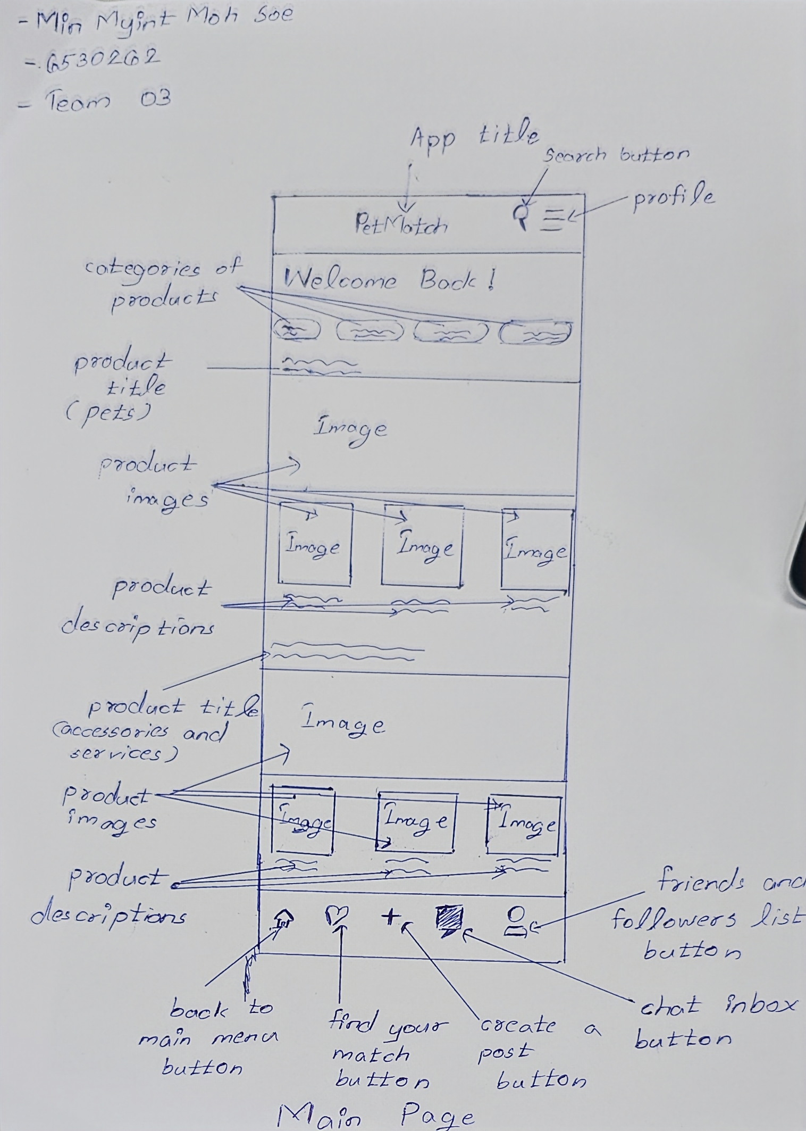
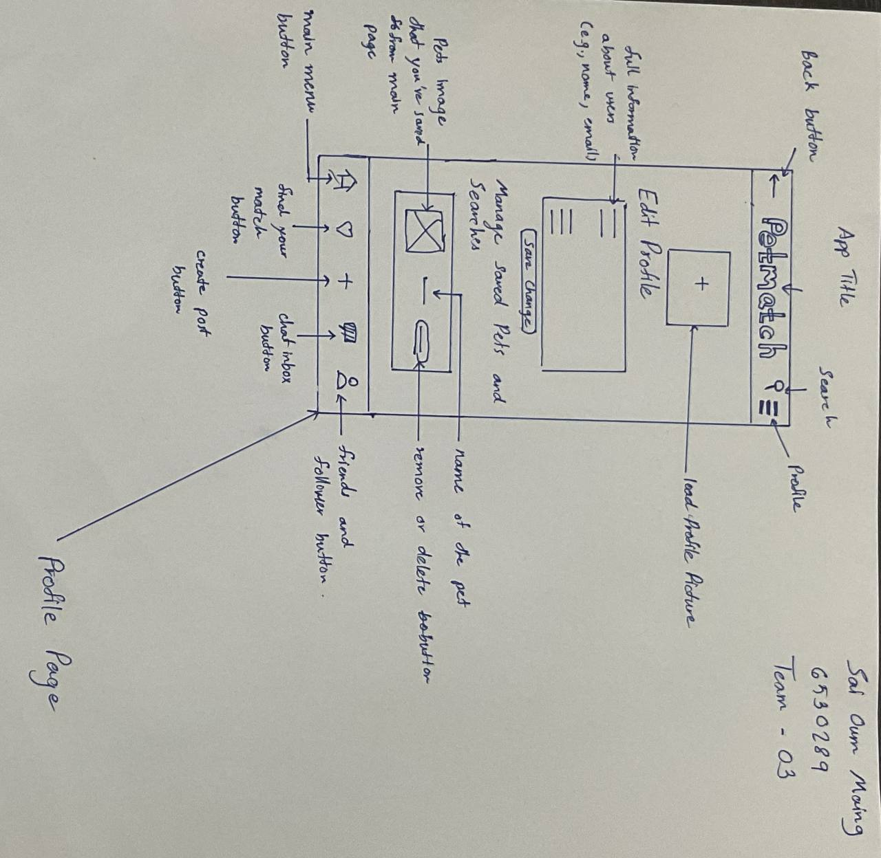
Sketch (1)
(Min Myint Moh Soe-6530262)
(Sai Oum Maing , 6530289)

Slide 7
Assignment: Do feature prioritization by using MoSCow analysis
40 mins
Objective
To understand and be able to do the feature prioritization by using the MoSCow analysis.
Instructions
Refer to your final project, list all features that you must have, should have, could have, and won’t have in your worksheet.

Slide 8
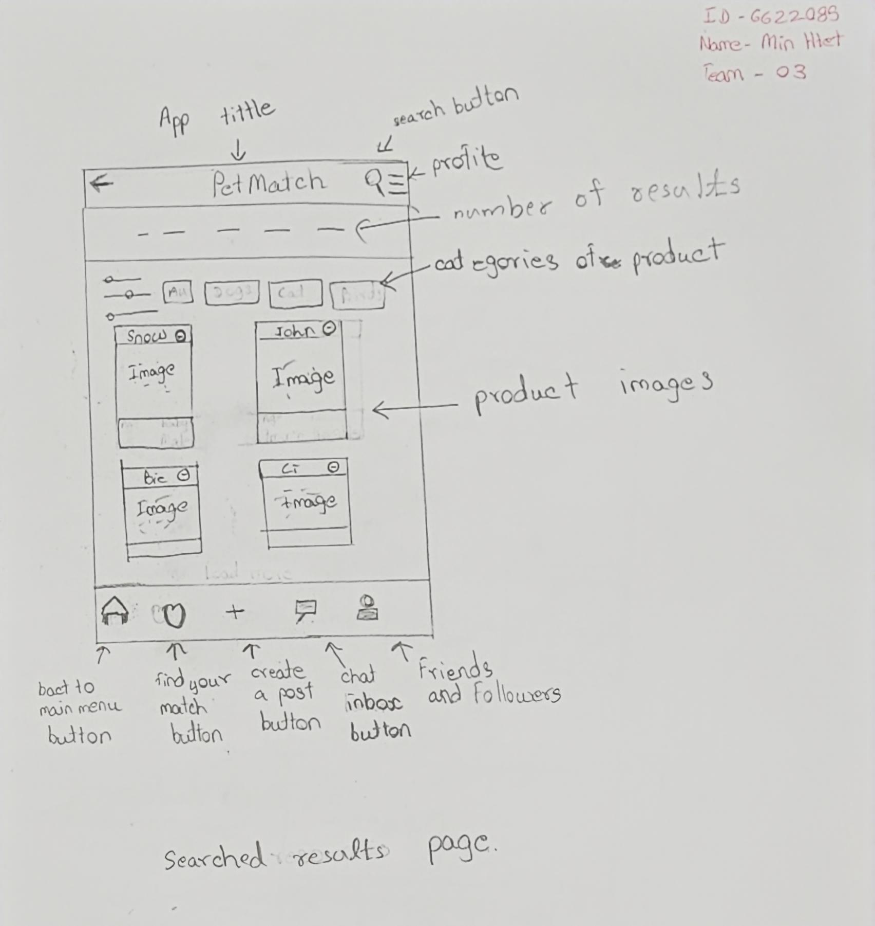
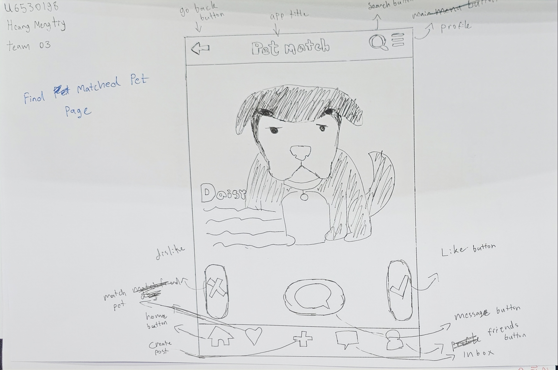
Sketch (2)
(Min Htet , 6622085)
(Heang Mengtry, 6530198)

Slide 9
Feature prioritization (example)
Must Have
Should Have
Could Have
Won’t Have
Search by camera
Search by image
Use AI to summarize information
Remove redundant information
Show one latest news
Show similar images
Show related videos
Show shops with min, max, and average price
Custom order of information
Provide more currencies
Add to favorite
Save search history
Crop image
Provide more languages
Custom order of similar images
Custom order of related videos
Custom order of shops
Search by text
Links to websites

Slide 10
Feature prioritization
Must Have
Should Have
Could Have
Won’t Have
User profile creation
Comprehensive pet information
Compatibility matching based on user
Search filters
Active communication with shops and shelters
Post-Adoption support
Guidance and resources recommendations
Marketplace for pet accessories
Marketplace for local pet services
User reviews and ratings
Community and knowledge sharing
Visual search feature
Social media integration
Multilingual support
Pop-up ads
Subscription fees
Premium memberships
Delivery service
Notes:
(3) Okay. However user profile creation is not an important feature.

Slide 11
Assignment : Do feature prioritization by using MoSCow analysis
Grading Criteria
0 = Blank
1 = Less than 3 features are listed in must have and could have categories.
2 = Three or more features are listed in must have and could have categories.
3 = Three or more features are listed in must have and could have categories and other features are listed in could have and won’t have categories.

